Slide 1


WELCOME TO
RISE
2025
Open House
Research, Innovation, Society and Entrepreneurship
Prof.Srinath Srinivasa
Dean (R&D), IIIT-Bangalore
sri@iiitb.ac.in

Slide 2
RISE @ IIIT-B
Premier outreach event of the institute to bring the essential institutional pillars together and engage with the society
Started in 2017
Ninth edition NOW (3 day event)!
Scale and Scope larger
RISE 2025
March 21, 2025
March 22, 2025
March 28, 2025
Innovation Conclave: Empowering the future: The 5G/6G disrupt
Open House
Research Colloquium (Internal event)

Slide 3
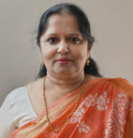
Open House@ RISE 2025
RISE 2025 Keynote : Ms. Suma Varughese, a Distinguished Scientist, assumed charge as Director General MED, CoS & CS (MCC) at DRDO
Poster Session & Demos
Deep Dive sessions

Slide 4
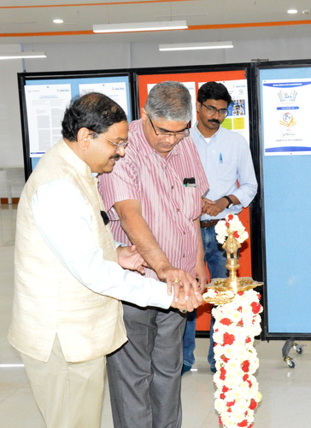
Poster Session & Demos
To showcase the latest research from various labs, centres & groups
Posters in our research centres, labs and MINRO experience center
Deep Dive Sessions
Parallel sessions of talks from faculty members
Advanced research topics (latest research in focus)
Knowledge Enhancement Program

Slide 5

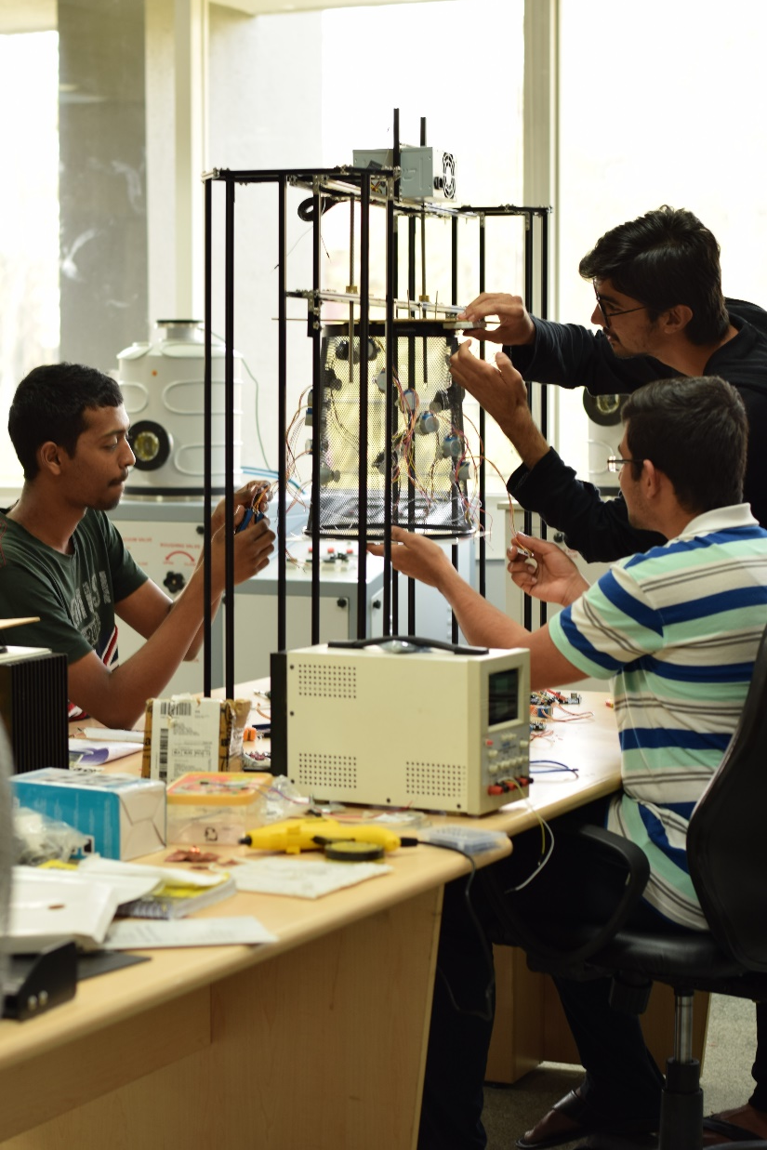
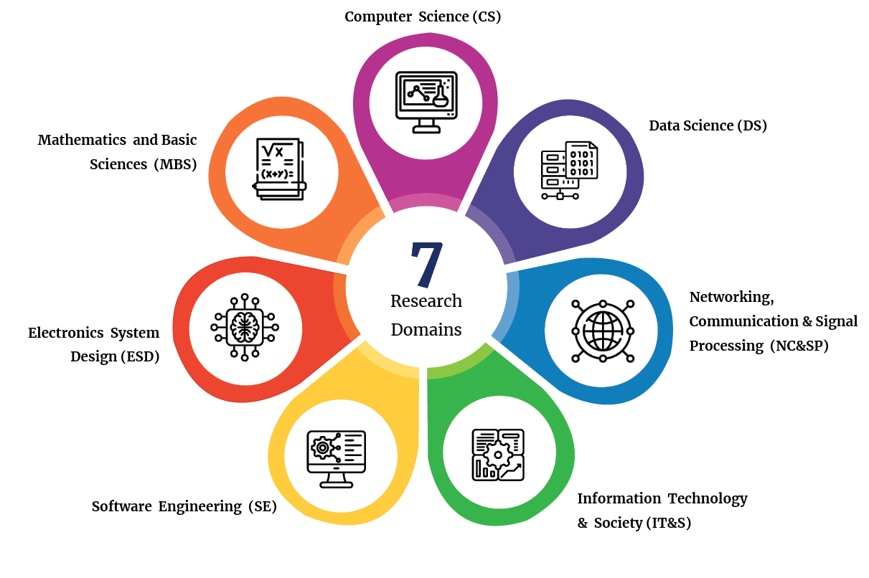
Research Domains

Slide 6






IIIT-B Centers of Excellence
MINRO & CIET, ITBT GoK
EHRC
CITAPP
Machine Intelligence and Robotics Center
E-Health Research
Center
Center for IT and
Public Policy
MOSIP
COMET
CCC
Modular Open Source Identity Platform
Communications Enterprise Technologies
Mphasis Cognitive Computing Center
and many other Technological Centers

Slide 7
Research Outcomes
“If you cant measure it, you cant improve it –Peter Drucker”
Research Publications (2023-2024)– 191 + 121 (till date)
Patents under Review (2023-2024) -14

Slide 8
Research publications
No of Publications

Slide 9
Patents
No of patents

Slide 10

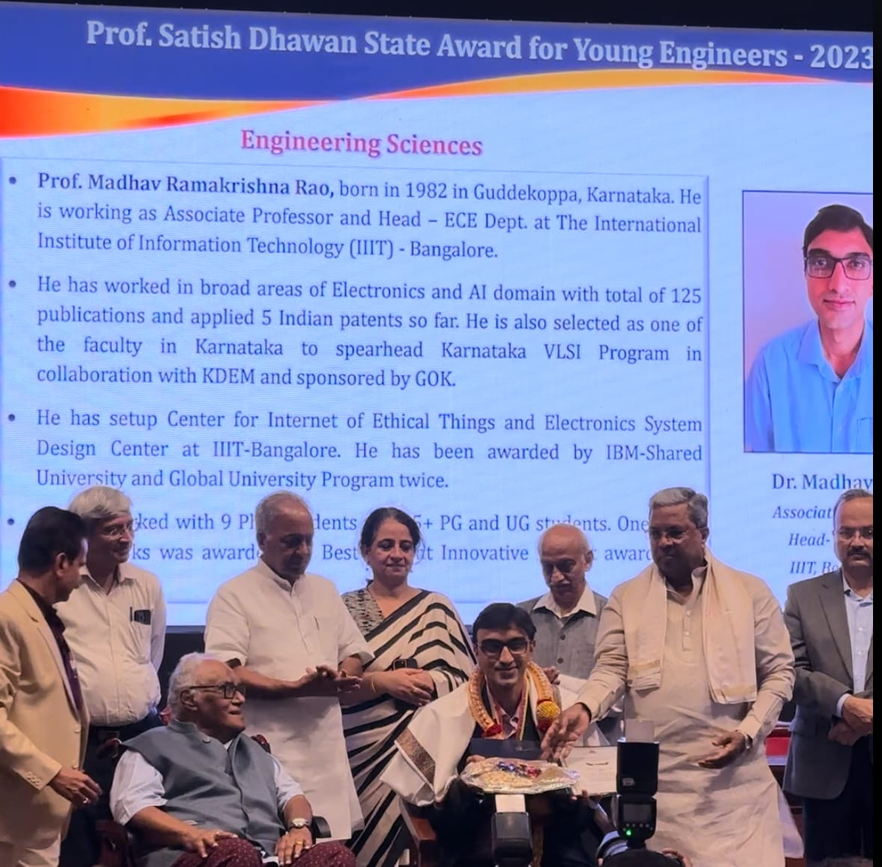
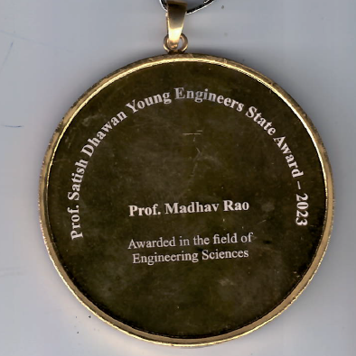
Faculty awards
Prof. Madhav Rao
Prof. Satish Dhawan Award for young Engineer

Slide 11
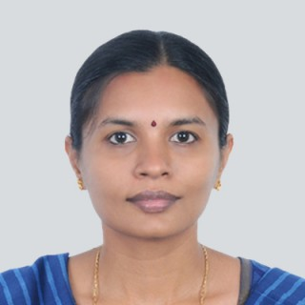
Faculty awards
Prof Meenakshi Dzousa
Outstanding Contribution to Computing Education (OCCE) Award for 2024 from ACM India.

Slide 12
Social impact
MOSIP – Creating a Unique Identity platform and helping developing countries to help them reach their citizens with Welfare measures.
Telemanas: To better the access to quality mental health counselling and care services
A Data Lake helping the Planning Department with the technical support required to analyze data from Women and Childcare (WCD) and Rural Development and Panchayat Raj (RDPR).’
Advanced Communication systems 5G, IOT and 6G
Research, Think and create better accessibility to differently abled people
Place data at the center of planning and execution of government policies in Karnataka
Cobots and autonomous robotics

Slide 13
Open House@ RISE 2025
A peep into our labs and latest research through posters and demos
If you are interested in further studies-- interact with researchers to get inspired and motivated
If you wish to collaborate with IIIT-B, you can see what we are currently capable of across domains
Looking for further studies.. we show some possible ways !
Welcome once again to
& Hope you have a great time at our institute!
Thank You !
RISE
2025
Open House

